Slide 2
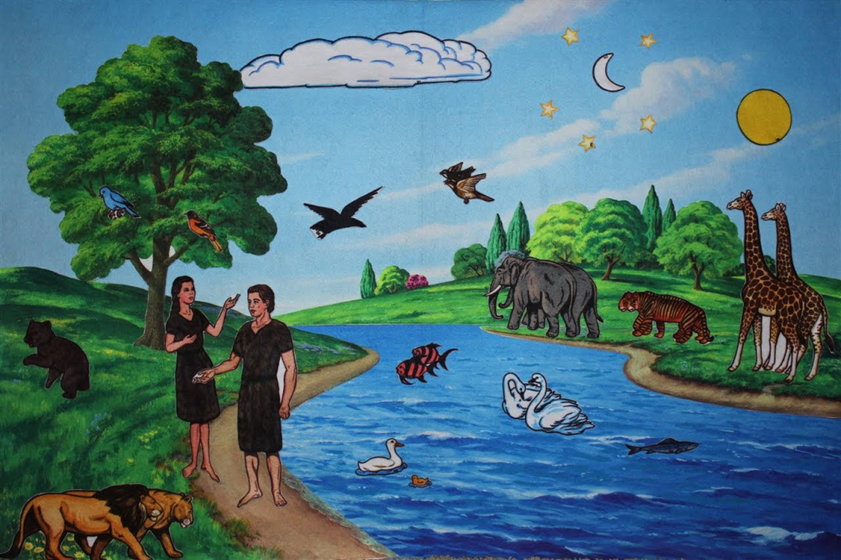
First reading Genesis 1:1-2:2
In the beginning God created the heavens and the earth. Now the earth was a formless void, there was darkness over the deep, and God’s spirit hovered over the water.
God said, ‘Let there be light’, and there was light.

Slide 3
First reading Genesis 1:1-2:2
God saw that light was good, and God divided light from darkness. God called light ‘day’, and darkness he called ‘night.’ Evening came and morning came: the first day. God said, ‘Let there be a vault in the waters to divide the waters in two.’

Slide 4
First reading Genesis 1:1-2:2
And so it was. God made the vault, and it divided the waters above the vault from the waters under the vault. God called the vault ‘heaven.’ Evening came and morning came: the second day.

Slide 5
First reading Genesis 1:1-2:2
God said, ‘Let the waters under heaven come together into a single mass, and let dry land appear.’ And so it was. God called the dry land ‘earth’ and the mass of waters ‘seas’, and God saw that it was good.

Slide 6
First reading Genesis 1:1-2:2
God said, ‘Let the earth produce vegetation: seed-bearing plants, and fruit trees bearing fruit with their seed inside, on the earth.’ And so it was. The earth produced vegetation: plants bearing seed in their several kinds, and trees bearing fruit with their seed inside in their several kinds.

Slide 7
First reading Genesis 1:1-2:2
God saw that it was good. Evening came and morning came: the third day. God said, ‘Let there be lights in the vault of heaven to divide day from night, and let them indicate festivals, days and years. Let them be lights in the vault of heaven to shine on the earth.’

Slide 8
First reading Genesis 1:1-2:2
And so it was. God made the two great lights: the greater light to govern the day, the smaller light to govern the night, and the stars. God set them in the vault of heaven to shine on the earth, to govern the day and the night and to divide light from darkness.

Slide 9
First reading Genesis 1:1-2:2
God saw that it was good. Evening came and morning came: the fourth day. God said, ‘Let the waters teem with living creatures, and let birds fly above the earth within the vault of heaven.’

Slide 10
First reading Genesis 1:1-2:2
And so it was. God created great sea-serpents and every kind of living creature with which the waters teem, and every kind of winged creature. God saw that it was good.

Slide 11
First reading Genesis 1:1-2:2
God blessed them, saying, ‘Be fruitful, multiply, and fill the waters of the seas; and let the birds multiply upon the earth.’ Evening came and morning came: the fifth day.

Slide 12
First reading Genesis 1:1-2:2
God said, ‘Let the earth produce every kind of living creature: cattle, reptiles, and every kind of wild beast.’ And so it was. God made every kind of wild beast, every kind of cattle, and every kind of land reptile. God saw that it was good.

Slide 13
First reading Genesis 1:1-2:2
God said, ‘Let us make man in our own image, in the likeness of ourselves, and let them be masters of the fish of the sea, the birds of heaven, the cattle, all the wild beasts and all the reptiles that crawl upon the earth.’

Slide 14
First reading Genesis 1:1-2:2
God created man in the image of himself, in the image of God he created him, male and female he created them. God blessed them, saying to them, ‘Be fruitful, multiply, fill the earth and conquer it.

Slide 15
First reading Genesis 1:1-2:2
Be masters of the fish of the sea, the birds of heaven and all living animals on the earth.’ God said, ‘See, I give you all the seed-bearing plants that are upon the whole earth, and all the trees with seed-bearing fruit; this shall be your food.

Slide 16
First reading Genesis 1:1-2:2
To all wild beasts, all birds of heaven and all living reptiles on the earth I give all the foliage of plants for food.’ And so it was. God saw all he had made, and indeed it was very good. Evening came and morning came: the sixth day.

Slide 17
First reading Genesis 1:1-2:2
Thus heaven and earth were completed with all their array. On the seventh day God completed the work he had been doing. He rested on the seventh day after all the work he had been doing.

Slide 18
Shorter Version

Slide 19
First reading Genesis 1:1-2:2
In the beginning God created the heavens and the earth. God said, ‘Let us make man in our own image, in the likeness of ourselves, and let them be masters of the fish of the sea, the birds of heaven, the cattle, all the wild beasts and all the reptiles that crawl upon the earth.’

Slide 20
First reading Genesis 1:1-2:2
God created man in the image of himself, in the image of God he created him, male and female he created them. God blessed them, saying to them, ‘Be fruitful, multiply, fill the earth and conquer it.

Slide 21
First reading Genesis 1:1-2:2
Be masters of the fish of the sea, the birds of heaven and all living animals on the earth.’ God said, ‘See, I give you all the seed-bearing plants that are upon the whole earth, and all the trees with seed-bearing fruit; this shall be your food.

Slide 22
First reading Genesis 1:1-2:2
To all wild beasts, all birds of heaven and all living reptiles on the earth I give all the foliage of plants for food.’ And so it was. God saw all he had made, and indeed it was very good.

Slide 23
Responsorial Psalm:
Send forth your spirit, O Lord,
and renew the face of the earth.

Slide 24
Responsorial Psalm:
The Lord fills the earth
with his love.

Slide 25
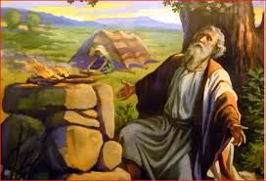
Second reading Genesis 22:1-18
God put Abraham to the test. ‘Abraham, Abraham’ he called. ‘Here I am’ he replied. ‘Take your son,’ God said ‘your only child Isaac, whom you love, and go to the land of Moriah. There you shall offer him as a burnt offering, on a mountain I will point out to you.’

Slide 26
Second reading Genesis 22:1-18
Rising early next morning Abraham saddled his ass and took with him two of his servants and his son Isaac. He chopped wood for the burnt offering and started on his journey to the place God had pointed out to him.

Slide 27
Second reading Genesis 22:1-18
On the third day Abraham looked up and saw the place in the distance. Then Abraham said to his servants, ‘Stay here with the donkey. The boy and I will go over there; we will worship and come back to you.’

Slide 28
Second reading Genesis 22:1-18
Abraham took the wood for the burnt offering, loaded it on Isaac, and carried in his own hands the fire and the knife. Then the two of them set out together. Isaac spoke to his father Abraham, ‘Father’ he said. ‘Yes, my son’ he replied.

Slide 29
Second reading Genesis 22:1-18
‘Look,’ he said ‘here are the fire and the wood, but where is the lamb for the burnt offering?’ Abraham answered, ‘My son, God himself will provide the lamb for the burnt offering.’ Then the two of them went on together.

Slide 30
Second reading Genesis 22:1-18
When they arrived at the place God had pointed out to him, Abraham built an altar there, and arranged the wood. Then he bound his son Isaac and put him on the altar on top of the wood. Abraham stretched out his hand and seized the knife to kill his son.

Slide 31
Second reading Genesis 22:1-18
But the angel of the Lord called to him from heaven. ‘Abraham, Abraham’ he said. ‘I am here’ he replied. ‘Do not raise your hand against the boy’ the angel said. ‘Do not harm him, for now I know you fear God.

Slide 32
Second reading Genesis 22:1-18
You have not refused me your son, your only son.’ Then looking up, Abraham saw a ram caught by its horns in a bush. Abraham took the ram and offered it as a burnt-offering in place of his son.

Slide 33
Second reading Genesis 22:1-18
Abraham called this place ‘The Lord Provides’, and hence the saying today: On the mountain the Lord provides.
The angel of the Lord called Abraham a second time from heaven. ‘I swear by my own self – it is the Lord who speaks –

Slide 34
Second reading Genesis 22:1-18
because you have done this, because you have not refused me your son, your only son, I will shower blessings on you, I will make your descendants as many as the stars of heaven and the grains of sand on the seashore.

Slide 35
Second reading Genesis 22:1-18
Your descendants shall gain possession of the gates of their enemies. All the nations of the earth shall bless themselves by your descendants, as a reward for your obedience.’

Slide 36
Shorter Version

Slide 37
Second reading Genesis 22:1-2,9-13,15
God put Abraham to the test. ‘Abraham, Abraham’ he called. ‘Here I am’ he replied. ‘Take your son,’ God said ‘your only child Isaac, whom you love, and go to the land of Moriah. There you shall offer him as a burnt offering, on a mountain I will point out to you.’

Slide 38
Second reading Genesis 22:1-2,9-13,15
When they arrived at the place God had pointed out to him, Abraham built an altar there, and arranged the wood. Then he bound his son Isaac and put him on the altar on top of the wood. Abraham stretched out his hand and seized the knife to kill his son.

Slide 39
Second reading Genesis 22:1-2,9-13,15
But the angel of the Lord called to him from heaven. ‘Abraham, Abraham’ he said. ‘I am here’ he replied. ‘Do not raise your hand against the boy’ the angel said. ‘Do not harm him, for now I know you fear God.

Slide 40
Second reading Genesis 22:1-2,9-13,15
You have not refused me your son, your only son.’ Then looking up, Abraham saw a ram caught by its horns in a bush. Abraham took the ram and offered it as a burnt-offering in place of his son.

Slide 41
Second reading Genesis 22:1-2,9-13,15
The angel of the Lord called Abraham a second time from heaven. ‘I swear by my own self – it is the Lord who speaks – because you have done this, because you have not refused me your son, your only son, I will shower blessings on you,

Slide 42
Second reading Genesis 22:1-2,9-13,15
I will make your descendants as many as the stars of heaven and the grains of sand on the seashore. Your descendants shall gain possession of the gates of their enemies. All the nations of the earth shall bless themselves by your descendants, as a reward for your obedience.’

Slide 43
Responsorial Psalm:
Preserve me, God, I take refuge in you

Slide 44
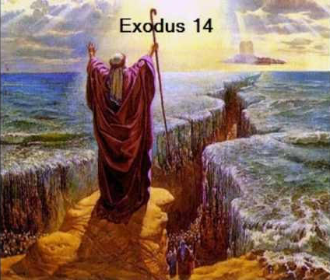
Third reading Exodus 14:15-15:1
The Lord said to Moses, ‘Why do you cry to me so? Tell the sons of Israel to march on. For yourself, raise your staff and stretch out your hand over the sea and part it for the sons of Israel to walk through the sea on dry ground.

Slide 45
Third reading Exodus 14:15-15:1
I for my part will make the heart of the Egyptians so stubborn that they will follow them. So shall I win myself glory at the expense of Pharaoh, of all his army, his chariots, his horsemen. And when I have won glory for myself, at the expense of Pharaoh and his chariots and his army, the Egyptians will learn that I am the Lord.’

Slide 46
Third reading Exodus 14:15-15:1
Then the angel of God, who marched at the front of the army of Israel, changed station and moved to their rear. The pillar of cloud changed station from the front to the rear of them, and remained there. It came between the camp of the Egyptians and the camp of Israel.

Slide 47
Third reading Exodus 14:15-15:1
The cloud was dark, and the night passed without the armies drawing any closer the whole night long. Moses stretched out his hand over the sea. The Lord drove back the sea with a strong easterly wind all night, and he made dry land of the sea.

Slide 48
Third reading Exodus 14:15-15:1
The waters parted and the sons of Israel went on dry ground right into the sea, walls of water to right and to left of them. The Egyptians gave chase: after them they went, right into the sea, all Pharaoh’s horses, his chariots, and his horsemen.

Slide 49
Third reading Exodus 14:15-15:1
In the morning watch, the Lord looked down on the army of the Egyptians from the pillar of fire and of cloud, and threw the army into confusion. He so clogged their chariot wheels that they could scarcely make headway.

Slide 50
Third reading Exodus 14:15-15:1
‘Let us flee from the Israelites,’ the Egyptians cried. ‘The Lord is fighting for them against the Egyptians!’ ‘Stretch out your hand over the sea,’ the Lord said to Moses, ‘that the waters may flow back on the Egyptians and their chariots and their horsemen.’

Slide 51
Third reading Exodus 14:15-15:1
Moses stretched out his hand over the sea and, as day broke, the sea returned to its bed. The fleeing Egyptians marched right into it, and the Lord overthrew the Egyptians in the very middle of the sea.

Slide 52
Third reading Exodus 14:15-15:1
The returning waters overwhelmed the chariots and the horsemen of Pharaoh’s whole army, which had followed the Israelites into the sea; not a single one of them was left. But the sons of Israel had marched through the sea on dry ground, walls of water to right and to left of them.

Slide 53
Third reading Exodus 14:15-15:1
That day, the Lord rescued Israel from the Egyptians, and Israel saw the Egyptians lying dead on the shore. Israel witnessed the great act that the Lord had performed against the Egyptians,

Slide 54
Third reading Exodus 14:15-15:1
and the people venerated the Lord; they put their faith in the Lord and in Moses, his servant.
It was then that Moses and the sons of Israel sang this song in honour of the Lord:

Slide 55
Responsorial Psalm:
I will sing to the Lord, glorious his triumph!

Slide 56
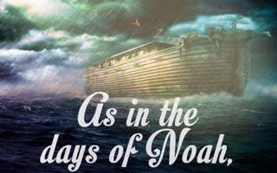
Fourth reading Isaiah 54:5-14
Thus says the Lord:
Now your creator will be your husband,
his name, the Lord of Hosts; your redeemer will be the Holy One of Israel, he is called the God of the whole earth.

Slide 57
Fourth reading Isaiah 54:5-14
Yes, like a forsaken wife, distressed in spirit,
the Lord calls you back.
Does a man cast off the wife of his youth?
says your God.

Slide 58
Fourth reading Isaiah 54:5-14
I did forsake you for a brief moment, but with great love will I take you back. In excess of anger, for a moment I hid my face from you. But with everlasting love I have taken pity on you, says the Lord, your redeemer.

Slide 59
Fourth reading Isaiah 54:5-14
I am now as I was in the days of Noah when I swore that Noah’s waters should never flood the world again. So now I swear concerning my anger with you and the threats I made against you;

Slide 60
Fourth reading Isaiah 54:5-14
for the mountains may depart, the hills be shaken, but my love for you will never leave you
and my covenant of peace with you will never be shaken, says the Lord who takes pity on you.

Slide 61
Fourth reading Isaiah 54:5-14
Unhappy creature, storm-tossed, disconsolate, see, I will set your stones on carbuncles and your foundations on sapphires.
I will make rubies your battlements, your gates crystal, and your entire wall precious stones.

Slide 62
Fourth reading Isaiah 54:5-14
Your sons will all be taught by the Lord. The prosperity of your sons will be great. You will be founded on integrity; remote from oppression, you will have nothing to fear; remote from terror, it will not approach you.

Slide 63
Responsorial Psalm:
I will praise you, Lord, you have rescued me.

Slide 64
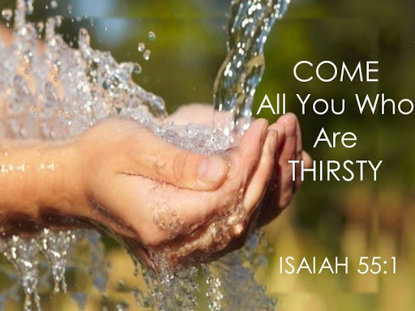
Fifth reading Isaiah 55:1-11
Thus says the Lord:
Oh, come to the water all you who are thirsty;
though you have no money, come! Buy corn without money, and eat,
and, at no cost, wine and milk.

Slide 65
Fifth reading Isaiah 55:1-11
Why spend money on what is not bread, your wages on what fails to satisfy? Listen, listen to me, and you will have good things to eat and rich food to enjoy. Pay attention, come to me;
listen, and your soul will live.

Slide 66
Fifth reading Isaiah 55:1-11
With you I will make an everlasting covenant
out of the favours promised to David.
See, I have made of you a witness to the peoples,
a leader and a master of the nations.

Slide 67
Fifth reading Isaiah 55:1-11
See, you will summon a nation you never knew,
those unknown will come hurrying to you,
for the sake of the Lord your God, of the Holy One of Israel who will glorify you.

Slide 68
Fifth reading Isaiah 55:1-11
Seek the Lord while he is still to be found, call to him while he is still near. Let the wicked man abandon his way, the evil man his thoughts. Let him turn back to the Lord who will take pity on him, to our God who is rich in forgiving;

Slide 69
Fifth reading Isaiah 55:1-11
for my thoughts are not your thoughts, my ways not your ways – it is the Lord who speaks. Yes, the heavens are as high above earth as my ways are above your ways, my thoughts above your thoughts.

Slide 70
Fifth reading Isaiah 55:1-11
Yes, as the rain and the snow come down from the heavens and do not return without watering the earth, making it yield and giving growth to provide seed for the sower and bread for the eating,

Slide 71
Fifth reading Isaiah 55:1-11
so the word that goes from my mouth does not return to me empty, without carrying out my will and succeeding in what it was sent to do.

Slide 72
Responsorial Psalm:
With joy you will draw water from the wells of salvation.

Slide 73
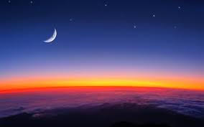
Sixth reading Baruch 3:9-15,32-4:4
Listen, Israel, to commands that bring life; hear, and learn what knowledge means. Why, Israel, why are you in the country of your enemies,
growing older and older in an alien land, sharing defilement with the dead,
reckoned with those who go to Sheol?

Slide 74
Sixth reading Baruch 3:9-15,32-4:4
Because you have forsaken the fountain of wisdom.
Had you walked in the way of God, you would have lived in peace for ever. Learn where knowledge is, where strength, where understanding, and so learn
where length of days is, where life,

Slide 75
Sixth reading Baruch 3:9-15,32-4:4
where the light of the eyes and where peace.
But who has found out where she lives, who has entered her treasure house? But the One who knows all knows her,
he has grasped her with his own intellect,

Slide 76
Sixth reading Baruch 3:9-15,32-4:4
he has set the earth firm for ever and filled it with four-footed beasts.
He sends the light – and it goes, he recalls it – and trembling it obeys;
the stars shine joyfully at their set times:

Slide 77
Sixth reading Baruch 3:9-15,32-4:4
when he calls them, they answer, ‘Here we are’;
they gladly shine for their creator. It is he who is our God, no other can compare with him. He has grasped the whole way of knowledge,
and confided it to his servant Jacob,

Slide 78
Sixth reading Baruch 3:9-15,32-4:4
to Israel his well-beloved;
so causing her to appear on earth and move among men. This is the book of the commandments of God, the Law that stands for ever; those who keep her live, those who desert her die.

Slide 79
Sixth reading Baruch 3:9-15,32-4:4
Turn back, Jacob, seize her, in her radiance make your way to light:
do not yield your glory to another, your privilege to a people not your own. Israel, blessed are we: what pleases God has been revealed to us.

Slide 80
Responsorial Psalm:
You have the message of eternal life, O Lord.

Slide 81
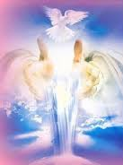
Seventh reading Ezekiel 36:16-17,18-28
The word of the Lord was addressed to me as follows: ‘Son of man, the members of the House of Israel used to live in their own land, but they defiled it by their conduct and actions. I then discharged my fury at them because of the blood they shed in their land and the idols with which they defiled it.

Slide 82
Seventh reading Ezekiel 36:16-17,18-28
I scattered them among the nations and dispersed them in foreign countries. I sentenced them as their conduct and actions deserved. And now they have profaned my holy name among the nations where they have gone, so that people say of them,

Slide 83
Seventh reading Ezekiel 36:16-17,18-28
“These are the people of the Lord; they have been exiled from his land.” ‘But I have been concerned about my holy name, which the House of Israel has profaned among the nations where they have gone. ‘And so, say to the House of Israel, “The Lord says this:

Slide 84
Seventh reading Ezekiel 36:16-17,18-28
I am not doing this for your sake, House of Israel, but for the sake of my holy name, which you have profaned among the nations where you have gone. I mean to display the holiness of my great name, which has been profaned among the nations, which you have profaned among them.

Slide 85
Seventh reading Ezekiel 36:16-17,18-28
And the nations will learn that I am the Lord – it is the Lord who speaks – when I display my holiness for your sake before their eyes. Then I am going to take you from among the nations and gather you together from all the foreign countries, and bring you home to your own land.

Slide 86
Seventh reading Ezekiel 36:16-17,18-28
‘“I shall pour clean water over you and you will be cleansed; I shall cleanse you of all your defilement and all your idols. I shall give you a new heart, and put a new spirit in you; I shall remove the heart of stone from your bodies and give you a heart of flesh instead.

Slide 87
Seventh reading Ezekiel 36:16-17,18-28
I shall put my spirit in you, and make you keep my laws and sincerely respect my observances. You will live in the land which I gave your ancestors. You shall be my people and I will be your God’’’

Slide 88
Responsorial Psalm:
Like the deer that yearns for running streams, so my soul is yearning for you, my God.

Slide 89
Responsorial Psalm:
A pure heart create for me, O God.

Slide 90
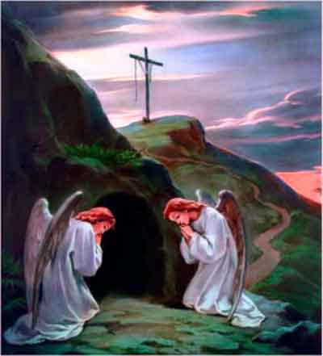
Romans 6:3-11
When we were baptised in Christ Jesus we were baptised in his death; in other words, when we were baptised we went into the tomb with him and joined him in death, so that as Christ was raised from the dead by the Father’s glory, we too might live a new life.

Slide 91
Romans 6:3-11
If in union with Christ we have imitated his death, we shall also imitate him in his resurrection. We must realise that our former selves have been crucified with him to destroy this sinful body and to free us from the slavery of sin.

Slide 92
Romans 6:3-11
When a Christian dies, of course, he has finished with sin. But we believe that having died with Christ we shall return to life with him: Christ, as we know, having been raised from the dead will never die again.

Slide 93
Romans 6:3-11
Death has no power over him any more. When he died, he died, once for all, to sin, so his life now is life with God; and in that way, you too must consider yourselves to be dead to sin but alive for God in Christ Jesus.

Slide 95
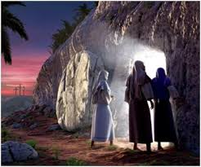
Gospel Luke 24: 1-12
On the first day of the week, at the first sign of dawn, they went to the tomb with the spices they had prepared. They found that the stone had been rolled away from the tomb, but on entering discovered that the body of the Lord Jesus was not there.

Slide 96
Gospel Luke 24: 1-12
As they stood there not knowing what to think, two men in brilliant clothes suddenly appeared at their side. Terrified, the women lowered their eyes. But the two men said to them, ‘Why look among the dead for someone who is alive? He is not here; he has risen.

Slide 97
Gospel Luke 24: 1-12
Remember what he told you when he was still in Galilee: that the Son of Man had to be handed over into the power of sinful men and be crucified, and rise again on the third day?’ And they remembered his words.

Slide 98
Gospel Luke 24: 1-12
When the women returned from the tomb they told all this to the Eleven and to all the others. The women were Mary of Magdala, Joanna, and Mary the mother of James.

Slide 99
Gospel Luke 24: 1-12
The other women with them also told the apostles, but this story of theirs seemed pure nonsense, and they did not believe them. Peter, however, went running to the tomb. He bent down and saw the binding cloths but nothing else; he then went back home, amazed at what had happened.

